Slide 1



Kuala Lumpur

Slide 2

SENTIMENT ANALYSIS ON NEWS ARTICLES FOR STOCKS
Track: 06.G. Computational Finance and Economics
AUTHORS:
Vaanchitha Kalyanaraman, VESIT
Rohan Tondulkar, VESIT
Sarah Kazi, VESIT
Sangeeta Oswal, VESIT

Slide 3
CONTENT
Abstract
Introduction
Experiment
Algorithm
Results
Conclusion
Future Scope
Acknowledgement
References

Slide 4
ABSTRACT
In this paper we have used sentiment analysis on news articles to see its effect on stock prices. We collected our dataset using Bing API which gave us links to news articles about a specific company.
As no pre-existing sentiment dictionary specifically for stock articles existed, we created a specialized sentiment dictionary only meant to analyze stock articles.
Two different machine learning algorithms were applied to the dataset and the accuracy of the two was compared. In order to test our results we attached an overall sentiment to each article in our data set which was compared to the predicted sentiment by the algorithm. We also compared the predicted results with the actual change in the stock prices on the market.
Notes:
important points
No detail

Slide 5
INTRODUCTION
Efficient Market Hypothesis - all stocks are valued after reflecting all relevant information about it.
Most news articles about stocks or the stock market are objective in nature.
No pre-existing sentiment dictionary for stocks.
11 companies from the Nifty 50 of the National Stock Exchange (NSE) of India were analyzed.
Notes:
Y stocks
EMH
We performed analysis on news
articles over a period and compared it with the change in
stock prices for the same period for a company. No past
data has been considered.
Diffculties faced..
11 companies

Slide 6
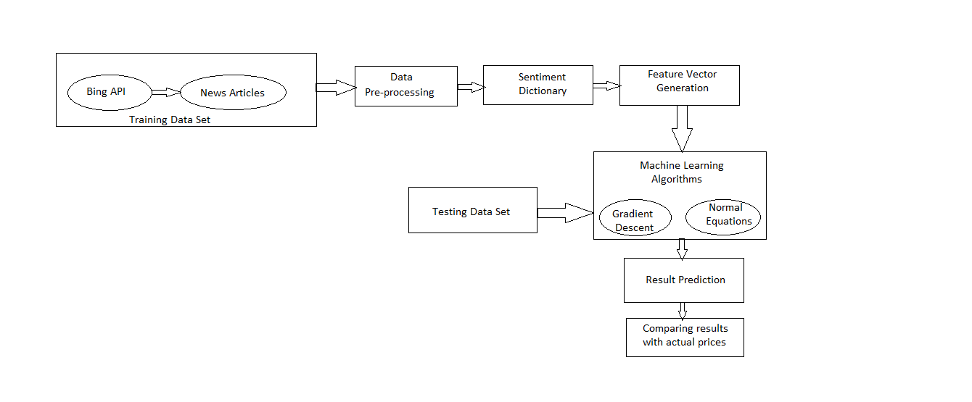
EXPERIMENT

Slide 7
DATASET
Selected 11 companies under India’s National Stock Exchange (NSE)
Used Bing API to get news Articles.
Training Dataset
120 news articles from 6 companies.
Sentiment attached to each news article.
Helped Machine Learning Algorithm for hypothesis.
Testing Dataset
500 news articles from 11 companies.
Used by Machine Learning Algorithm for prediction.

Slide 8
DATA CLEANSING
Pre-processed the data to improve accuracy.
Only selected news articles relevant to the company.

Slide 9
SENTIMENT DICTIONARY
Created our own stock market specific sentiment dictionary.
To increase efficiency.
Example
Bull= Positive sentiment.
Bear= Negative sentiment.
Dictionary of 532 words.
266 positive words.
266 negative words.

Slide 10
FEATURE VECTOR GENERATION
Words from sentiment dictionary formed the features i.e. 532 features.
Fed to ML algorithms for hypothesis and prediction.
Program to find value of each feature for every article.
Value based on the frequency of that word in the article.
Example:
Positive word occurring 3 times: value=+3.
Negative word occurring 3 times: value=-3.

Slide 11
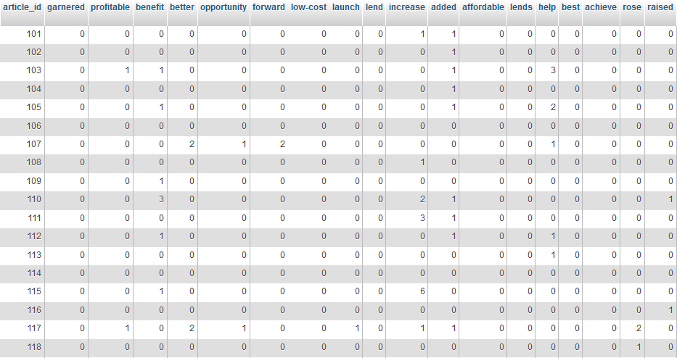
FEATURE VECTOR

Slide 12
IMPLEMENTATION
Applied two Machine Learning Algorithms to predict positive or negative impact on stocks.
Machine Learning Algorithms:
Linear Regression using Gradient Descent.
Linear Regression using Normal Equations.
Compared prediction with expected sentiment found manually.
Compared results with actual change in stock prices in the particular period in which we had collected news articles for the data set.

Slide 13
LINEAR REGRESSION
Supervised machine learning algorithm which is based upon building a linear hypothesis for a training data set.
Terms:
m= number of training samples.
n= number of features.
Θ= n+1 dimensional column vector consisting of parameters of the hypothesis.
X= feature vector (m * n+1).
The multivariable form of the hypothesis function is as follows:

Slide 14
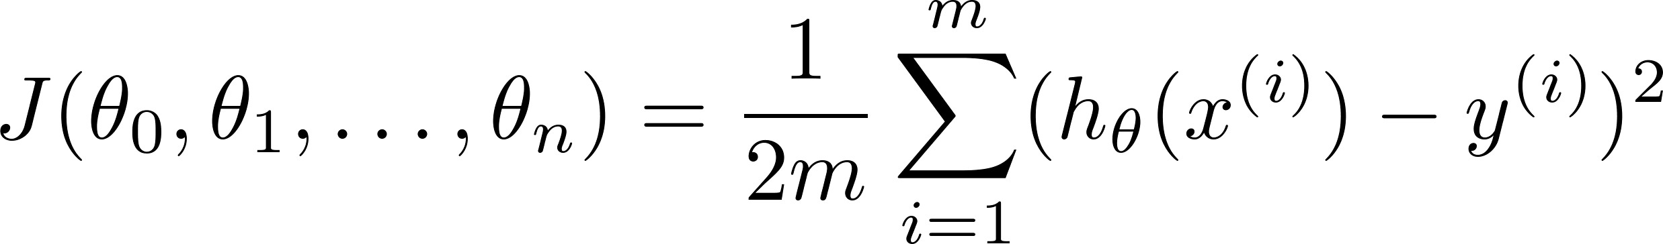
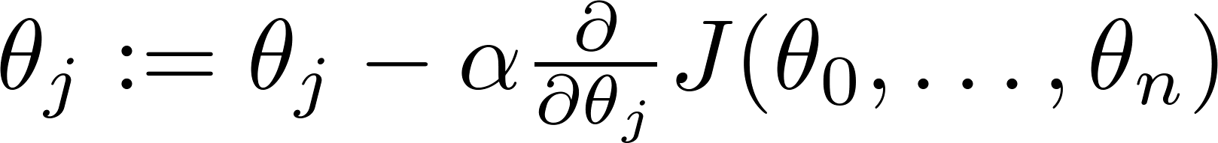
USING GRADIENT DESCENT
The value of a cost function J is minimized and the value of parameter vector θ is used for regression.
We aim to minimize cost function J over θ.
Gradient Descent Algorithm:
Repeat until convergence {
}

Slide 15
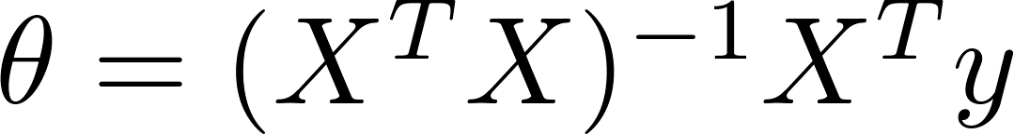
USING NORMAL EQUATION
The normal equations method is used to find optimum values of θ vector without iteration.
The parameter vector θ is given by:
This value of vector θ is used for continuous prediction.

Slide 16


RESULTS
ACCURACY ON COMPARISON OF PREDICTED SENTIMENT WITH EXPECTED SENTIEMNT USING LINEAR REGERESSION WITH NORMAL EQUATION.
ACCURACY ON COMPARISON OF PREDICTED SENTIMENT WITH EXPECTED SENTIEMNT USING LINEAR REGERESSION WITH GRADIENT DESCENT.

Slide 17
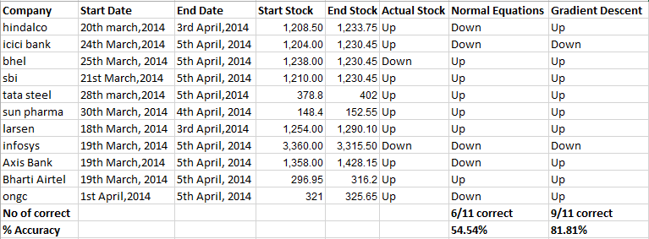
RESULTS
ACCURACY ON COMPARISON OF PREDICTED SENTIMENT WITH ACTUAL CHANCE OF STOCK PRICE IN MARKET

Slide 18
CONCLUSION
Results show an accuracy of 53.2% using Normal Equation and 59.5% using Gradient Descent when compared to the result manually predicted by us.
On comparison with actual stock prices also, Gradient Decent was more accurate with an accuracy of 81.82% while Normal Equation had an accuracy of only 54.54%.
Linear Regression using Gradient Descent is more efficient.

Slide 19
FUTURE WORK
Comprehensive sentiment dictionary – for all markets.
Give words more accurate weight than +1,-1. Non integral values can be considered based of effect of the word.
Mapping results from real time news data stream to the immediate changes in market.
Use more data mining algorithms for better results.

Slide 20
ACKNOWLEDGEMENT
We would like to thank our mentor and guide, Ms. Sangeeta Oswal for her constant guidance and support throughout out project.
We also express our gratitude to our professors in our college for their valuable timely guidance and co-operation for doing this project.

Slide 21
REFERENCES
Sehgal, V.; Song, C.; "SOPS: Stock Prediction Using Web Sentiment," Data Mining Workshops, 2007. ICDM Workshops 2007. Seventh IEEE International Conference on, vol., no., pp.21-26, 28-31 Oct. 2007.
Linear Regression with Multiple Variables [Online]. Available: http://www.holehouse.org/mlclass/04_Linear_Regression_with_multiple_variables.html, accessed February, 2014.
A. Mittal and A Goel, “Stock Prediction Using Twitter Sentiment Analysis” Standford University, CS229 (2011 http://cs229.stanford.edu/proj2011/GoelMittal-StockMarketPredictionUsingTwitterSentimentAnalysis.pdf).
Linear Regression with Multiple Variables [Online]. Available: https://share.coursera.org/wiki/index.php/ML:Linear_Regression_with_Multiple_Variables, accessed February, 2014.
N. Archak et al., “Deriving the Pricing Power of Product Features by Mining Consumer Reviews” (2008) . Working paper, New York University, New York.
P. C. Tetlock, “Giving Content to Investor Sentiment: The Role of Media in the Stock Market” J. Finance (2005) . Forthcoming.
V. H. Shah, “Machine learning techniques for stock prediction,” www.vatsals.com.
S. Shen et al., “Stock Market Forecasting Using Machine Learning Algorithms,” Stanford University, 2012 (http://cs229.stanford.edu/proj2012/ShenJiangZhang-StockMarketForecastingusingMachineLearningAlgorithms.pdf)
R. P. Schumaker, “Analyzing Representational Schemes of Financial News Articles,” in The Third China Summer Workshop on Information Systems, 2009.
G. Gidófalvi, “Using News Articles to Predict Stock Price Movements,” University of California, San Diego, Department of Computer Science and Engineering.

Slide 22
THANK YOU
QUESTIONS AND ANSWERS…

